Slide 1
ENSE 374
Milestone 2
-BLAUGRANES
Gift, Kyle, Ufuoma, Anirudh
23 October, 2019

Slide 2
User Stories
As a currently enrolled student at the University of Regina, I want to join a platform where fellow students can interact with each other in a fun and educative way.
As a member, I want to be able to create discussion threads where fellow students can comment and vote on posted threads and comments, and also see upcoming events for the general public and departments.
As a member, I want to be notified when threads are posted by students in my specified department.
Also, I want to be notified when a comment is posted on a particular thread I posted or commented on.

Slide 3
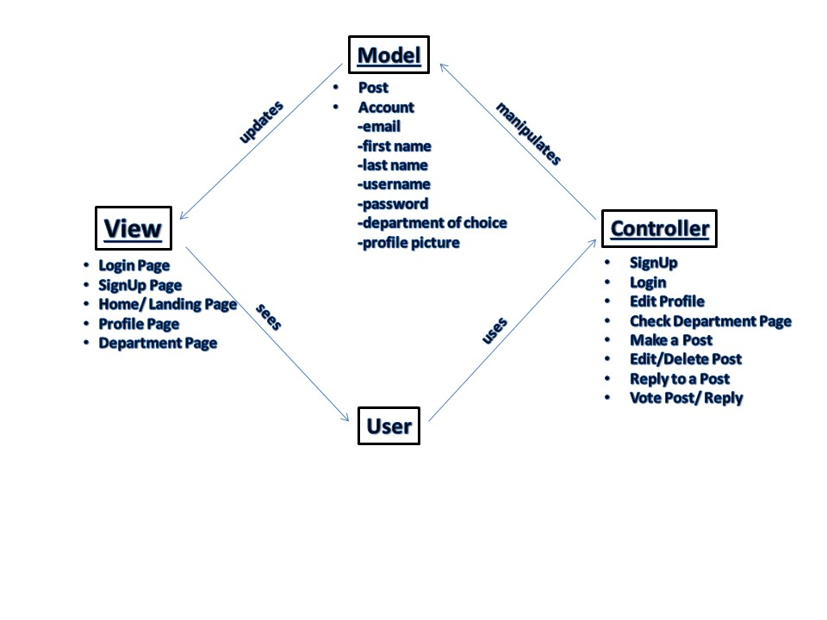
MVC Architecture
UofR Student Hub
This is a safe & educational platform where students currently enrolled at the University of Regina can interact, create and join discussions threads which will serve as a fun way to learn and exchange knowledge amongst one another.

Slide 4
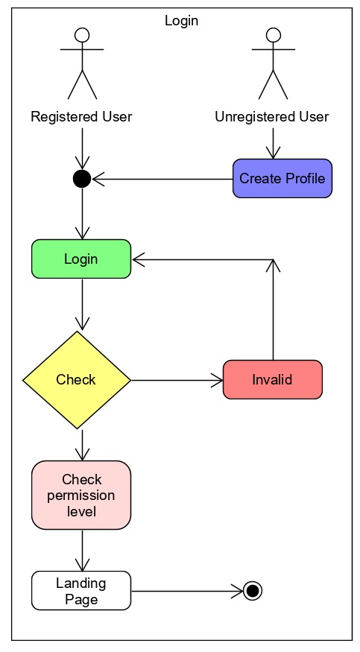
UML Diagram
Unregistered Users
Will be required to create a profile
Registered Users
Will be required to provide login information to be able to gain access into the UofR-Student-Hub

Slide 5
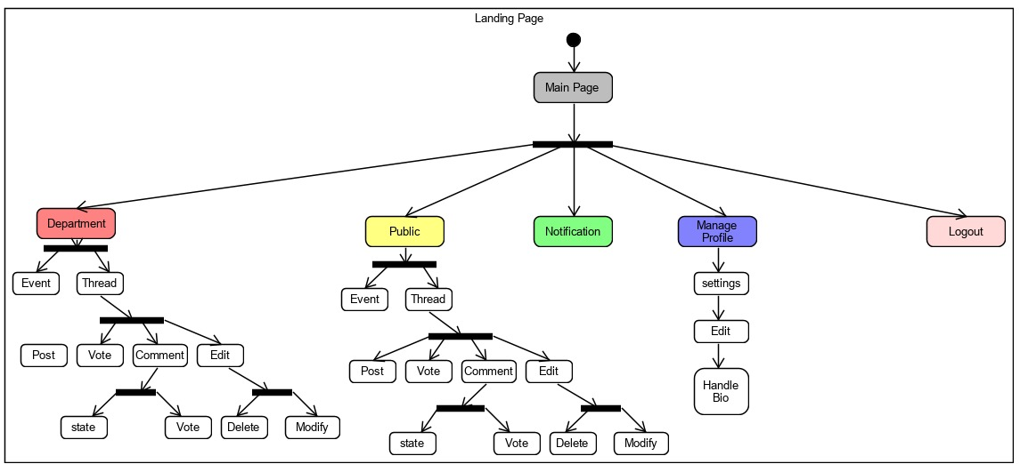
UML Diagrams

Slide 6
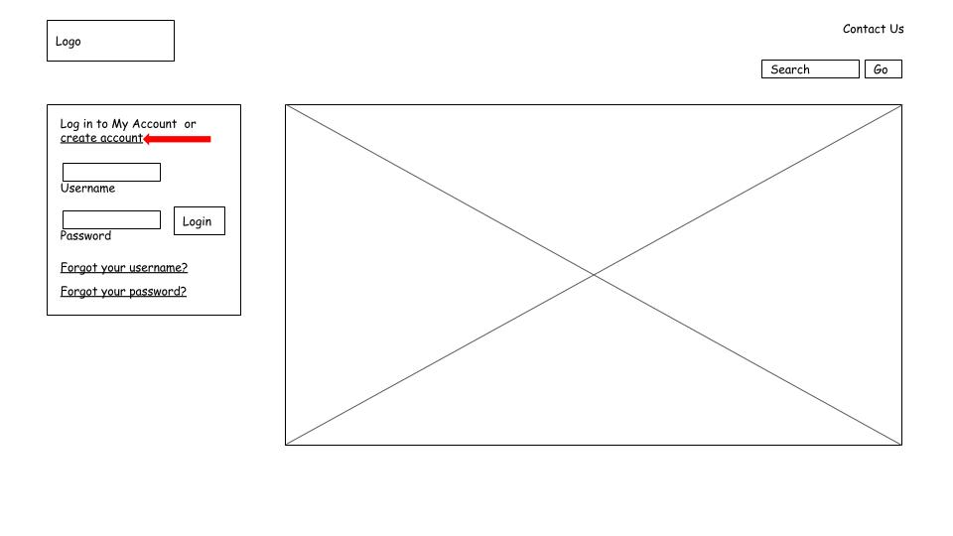
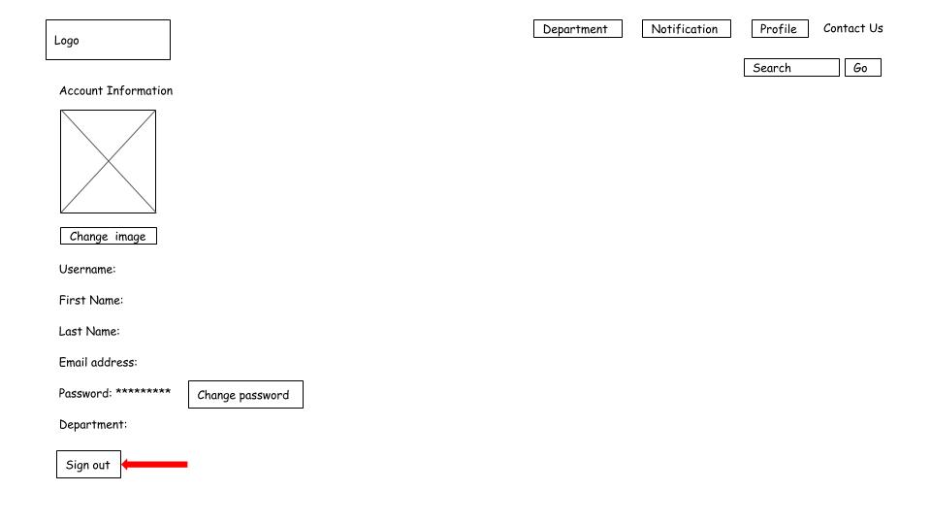
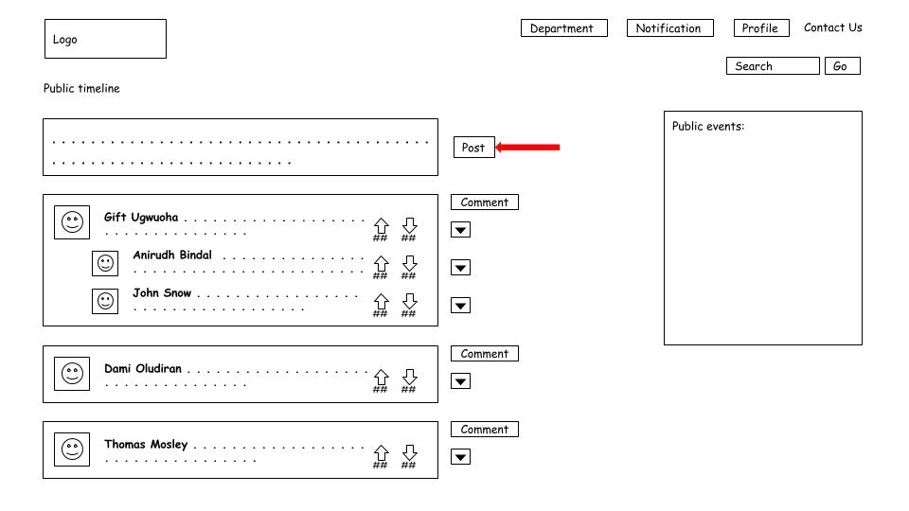
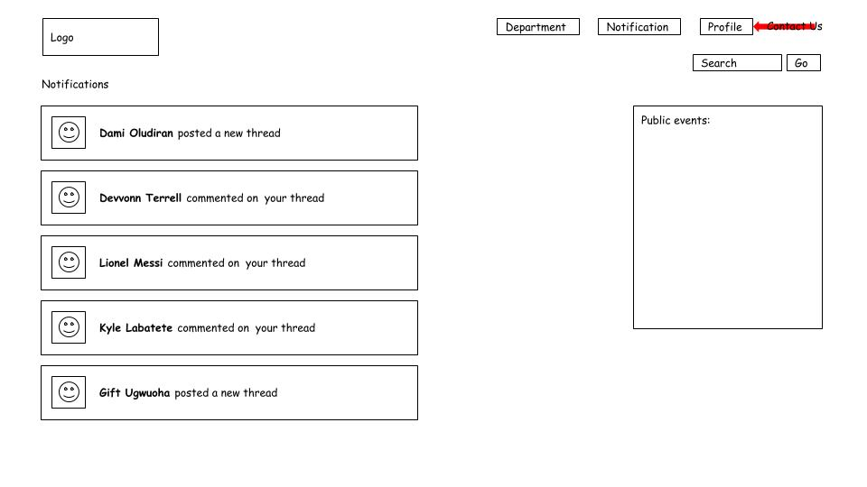
Lo-Fidelity Prototype
Login page
Profile page
Public
page
Notification page

Slide 7
KANBAN & GitHub Review
https://github.com/Blaugranes/UofR-Student-Hub/projects/1?fullscreen=true

Slide 8
Group Reflection
•How did you feel about this milestone? What did you like about it? What did you dislike?
-We liked how we became more collaborative and how we all had creative ideas.
•What did you learn about yourself as you collaborated and worked through this milestone?
-Strength: Collaboration
-Weakness: Procrastination
•How will you use what you have learned going forward?
-Going forward, will meet more often in order to get things done on time.
•What “stuff & things” related to this milestone would you want help with?
-We could really use some help with the programming part

Slide 9


